Slide 1


Relationship Between Bitcoin Closing Prices and Sentiments
Presentation by Nathan, Renzo, and Poulami

Slide 2
What are We Doing?
We wanted to analyze the relationship between the closing prices of Bitcoin every day and people’s perception on cryptocurrency.
Hypothesis
We believe that the public’s perception on Bitcoin can influence the closing price of Bitcoin.

Slide 3

Dataset and Tools
On cryptodatadownload.com, we selected the Coinbase Exchange BTC Daily dataset from February 10, 2019 to July 8, 2020 and used it for analysis regarding price changes for Bitcoin.
We also used Twitter to gather tweets from Bitcoin News (@BTCTN) so that we could analyze negative, neutral, and positive opinions with the sentiment analysis techniques that we learned in R.

Slide 4
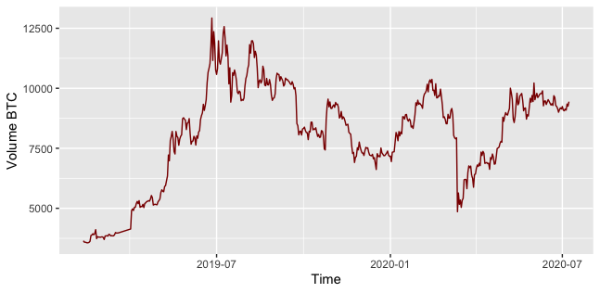
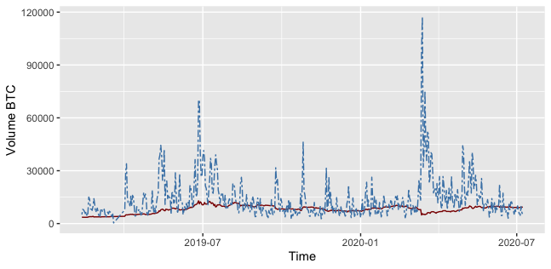
Insights from EDA
Price
During our EDA, we had a line graph where our independent variable is time and our dependent variable is the closing price of Bitcoin (See first graph). We also noticed a relationship between the volume of BTC and the rate of change of the price when reviewing our data (See second graph).

Slide 5
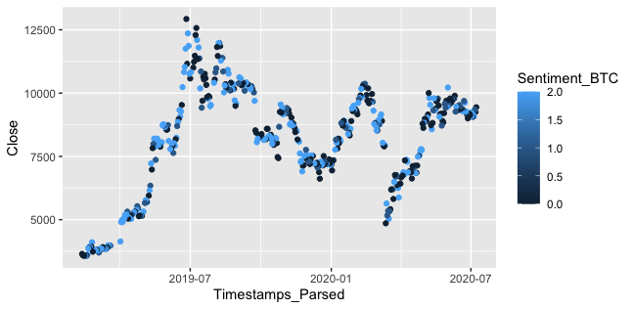
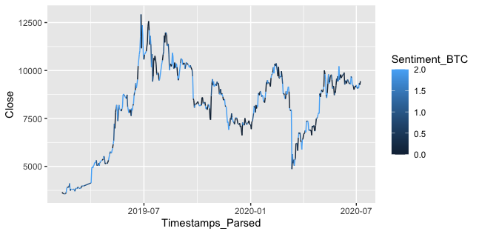
Models and Interpretations
Along with our basic EDA, we included a scatter plot that consists of points where the color of the point determines the stance of the opinion. Dark blue (0) represents a negative opinion, blue (1) represents a neutral opinion, and light blue (2) represents a positive opinion.
Notes:
Bitcoin news source on twitter
Totalling up net sentiment scoring
Merged datasets

Slide 6
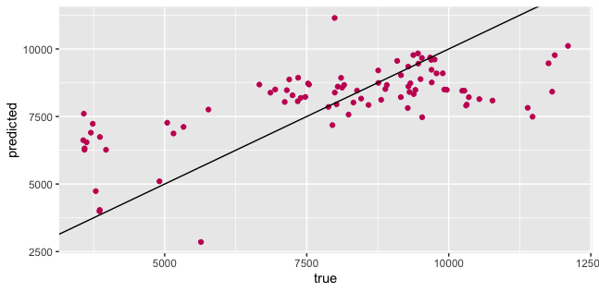
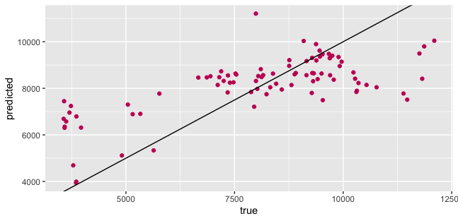
Models and Interpretations (continued)
Fitted a linear regression model from a training pool of 80% of our data.
Included factors of sentiment rating, sentiment count, timestamps, and volume traded to predict price.
Produced a graph that shows the ratio of our predicted values to the true ones.
R^2 = 0.353
Notes:
Tried a bunch of different models, close others, but this one seemed best
Ratio of predicted to true
Some accuracy but room for improvement with having some residuals

Slide 7

How Accurate are Our Models?
Fairly accurate for the limitations in data from Twitter
3200 posts for timeline data
Limited values to train with
Dataset that was originally around 200,000 in size
Still plenty of residuals from this data
Would try to fix with less limitations and more testing on our models
Notes:
Our models are fairly accurate for the limitations in data from Twitter. We only had a few hundred values to train off of, as compared to our dataset that was originally around 200,000 values big, after cleaning our bitcoin data to match our sentiment data. However, there are still plenty of residuals from this data, which we would try to fix with less limitations and more testing on our models so that we could have an accurate model.

Slide 8

Advice/Call to Action
Despite our results not being the most conclusive, there is evidence to suggest that this is a viable concept.
We found a company called CryptoMood. They claim to offer superior trading strategies by providing “real time Crypto sentiment signals ”.
This suggests that with more thorough and extensive data it could have worked much better.

Slide 9

Evaluation of Our Work
If we had more time to work on this project, we could have trained our data more to reach a linear regression that would make our residuals smaller.
We also could find other methods for scraping data that would have granted a larger data pool to pull from, which would likely impact the accuracy of our models.

Slide 10
Thank You for Listening!

